Slide 1
Integrated Photonics
Figures and Images for Instructors
Module 2
Silicon Photonic Integrated Circuits and Devices
Optics and Photonics Series

Slide 2
© 2018 University of Central Florida
This text was developed by the National Center for Optics and Photonics Education (OP-TEC), University of Central Florida, under NSF ATE grant 1303732. Any opinions, findings, and conclusions or recommendations expressed in this material are those of the author(s) and do not necessarily reflect the views of the National Science Foundation.
Published and distributed by
OP-TEC
University of Central Florida
http://www.op-tec.org
Permission to copy and distribute This work is licensed under the Creative Commons Attribution-NonCommercial-NoDerivatives 4.0 International License. http://creativecommons.org/licenses/by-nc-nd/4.0. Individuals and organizations may copy and distribute this material for non-commercial purposes. Appropriate credit to the University of Central Florida & the National Science Foundation shall be displayed, by retaining the statements on this page.

Slide 3
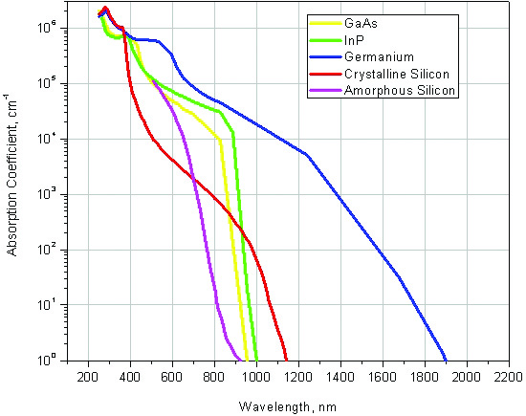
Figure 2-1 Absorption coefficient of different materials vs. wavelength

Slide 4
Figure 2-2 Index of refraction of silicon vs. wavelength

Slide 5
Figure 2-3 Components of a basic optical fiber transmission system

Slide 6
Figure 2-4 Long haul, regional, and metropolitan networks

Slide 7
Figure 2-5 Loss of power in optical fibers vs. wavelength

Slide 8
Figure 2-6 Effect of dispersion on light pulses transmitted through optical fibers

Slide 9
Figure 2-7 An optical communication system that regenerates the light signal along the transmission path

Slide 10
Figure 2-8 An optical communication system that amplifies the light signal along the transmission path

Slide 11
Figure 2-9 Effect of an amplifier vs. a repeater on a degraded optical signal

Slide 12
Figure 2-10 a) SOI material structure
Figure 2-10 b) Channel (or strip) SOI waveguide

Slide 13
Figure 2-11 Directional coupler device containing four S-bend waveguides to bring waveguides close to each other and then separate them

Slide 14
Figure 2-12 a) Light distribution in optical fiber (TEM₀₀)
Figure 2-12 b) SOI waveguide

Slide 15
Figure 2-13 a) Butt coupling; b) End-fire coupling; c) Grating coupling; d) Spot-size converter

Slide 16
Figure 2-14 Directional coupler splitting the incident power P₀ into powers P₁ and P₂ in the two output waveguides

Slide 17
Figure 2-15 Top: Single Y-branch splitting the incident power into equal powers in the two output waveguides. Bottom: Cascaded Y-branches.

Slide 18
Figure 2-16 Detailed layout of Y-branch device

Slide 19
Figure 2-17 Mach-Zehnder interferometer based on 3dB directional couplers

Slide 20
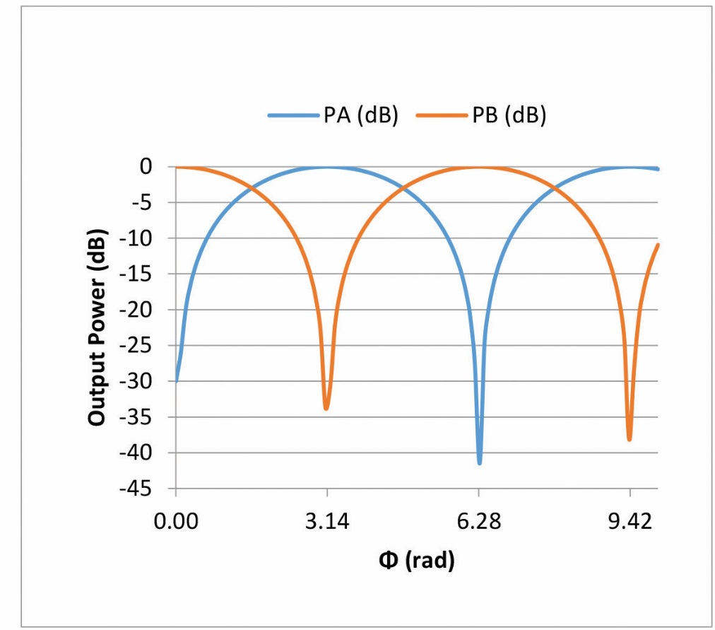
Figure 2-18 a) Output powers A and B, normalized to input power as a ratio vs. the phase difference between the interferometer arms
Figure 2-18 b) Output powers A and B, expressed in dB vs. the phase difference between the interferometer arms

Slide 21
Figure 2-19 MZI device used in biochemical sensing

Slide 22
Figure 2-20 Ring resonator PIC device

Slide 23
Figure 2-21 Notch filter transmission vs. wavelength. Resonant wavelengths appear at approximately 1531, 1541, and 1551 nm, with an FSR of about 10 nm.

Slide 24
Figure 2-22 Add-drop filter based on four-port ring resonator device

Slide 25
Figure 2-23 Add-drop filter transmission for the Through and Drop ports vs. wavelength. Resonant wavelengths once again appear at approximately 1531, 1541, and 1551 nm.

Slide 26
Figure 2-24 Add-drop filter in racetrack configuration

Slide 27
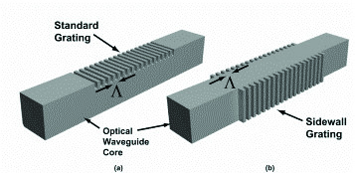
Figure 2-25 a) Optical fiber Bragg grating and core refractive index along fiber
Figure 2-25 b) Planar waveguide Bragg grating. In one, the grating sits at the top of the waveguide. In the other, the grating is created on the waveguide sidewalls.

Slide 28
Figure 2-26 Optical power reflected from a Bragg grating vs. wavelength

Slide 29
Figure 2-27 An SOI micro-ring modulator based on the plasma dispersion effect

Slide 30
Figure 2-28 Spectral responsivity of silicon PIN photodiodes

Slide 31
Figure 2-29 Silicon wafers containing many identical PIC devices created by the fabrication process described in Module 1

Slide 32
Figure 2-30 Dicing of wafer into individual devices. Courtesy of Advanced Motion Controls.

Slide 33
Figure 2-31 Fiber array fabrication

Slide 34
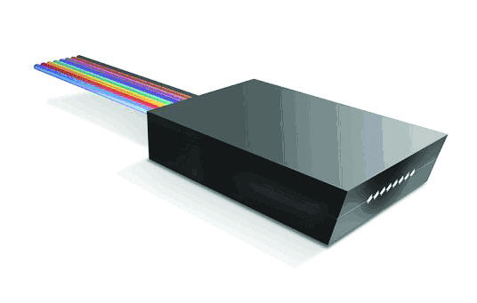
Figure 2-32 a) Fiber arrays, courtesy of AiDi
Figure 2-32 b) Fiber array, courtesy of Hantech. This fiber array is angle polished to avoid back reflections of the optical signal.

Slide 35
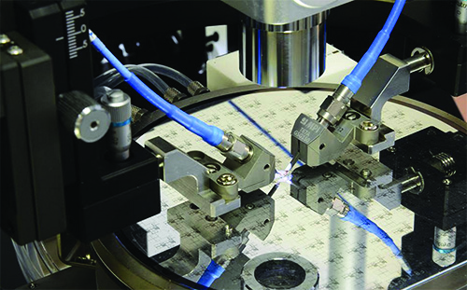
Figure 2-33 a) Wafer level testing of PICs, courtesy of ACTPHAST
Figure 2-33 b) Wafer level testing of PICs, courtesy of VI Systems

Slide 36
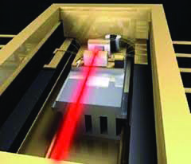
Figure 2-34 a) Typical diode laser package
Figure 2-34 b) Typical packaged device

Slide 37
Figure 2-35 Circuit board with individually packaged chips

Slide 38
Figure 2-36 Wire bond vs. flip-chip technologies

Slide 39
Figure 2-37 Example of a packaged 3D stacked system

Slide 40
Figure 2-38 A 2.5D system packaged using a silicon interposer and TSVs

Slide 41
Figure 2-39 A 3D system packaged using TSVs

Slide 42
Figure 2-40 Optical interconnect between two processor chips. Courtesy of APIC Corporation.

