Slide 1
Carbon Dioxide Lasers and Their Applications
Module 2-4
of
Course 2, Laser Systems and Applications
2nd Edition
www.op-tec.org

Slide 2
© 2018 University of Central Florida
This text was developed by the National Center for Optics and Photonics Education (OP-TEC), University of Central Florida, under NSF ATE grant 1303732. Any opinions, findings, and conclusions or recommendations expressed in this material are those of the author(s) and do not necessarily reflect the views of the National Science Foundation.
Published and distributed by
OP-TEC
University of Central Florida
http://www.op-tec.org
Permission to copy and distribute This work is licensed under the Creative Commons Attribution-NonCommercial-NoDerivatives 4.0 International License. http://creativecommons.org/licenses/by-nc-nd/4.0. Individuals and organizations may copy and distribute this material for non-commercial purposes. Appropriate credit to the University of Central Florida & the National Science Foundation shall be displayed, by retaining the statements on this page.

Slide 3
Figure 4-1 Vibrational and rotational modes of a diatomic molecule

Slide 4
Figure 4-2 Vibrational and rotational energy levels in a diatomic molecule (levels not to same scale)

Slide 5
Figure 4-3 Normal modes of vibration for ${CO}_{2}$molecules

Slide 6
Figure 4-4 Simplified energy-level diagram for ${CO}_{2}$ laser showing vibrational energy transfer

Slide 7
Figure 4-5 Simple coaxial flowing ${CO}_{2}$ laser

Slide 8
Figure 4-6 Optical and electrical system of 250 W ${CO}_{2}$ laser (overall length of laser head=3m)

Slide 9
Figure 4-7 Fast axial flow CW ${CO}_{2}$ laser

Slide 10
Figure 4-8 Unstable resonator

Slide 11
Figure 4-9 Traverse flow CW ${CO}_{2}$ laser

Slide 12
Figure 4-10 Typical configuration of a gas transport laser. The optical axis is perpendicular to the page

Slide 13
Figure 4-11 Oscilloscope trace of mode-locked train of pulses from a ${CO}_{2}$ lasers, 200ns/division

Slide 14
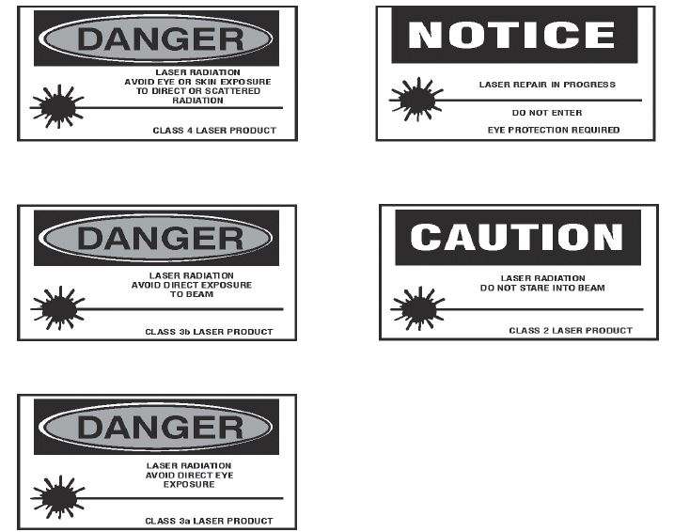
Figure 4-12 Laser area warning signs

