Slide 1
Systems Integration in Photonics
Module 2-10
of
Course 2, Laser Systems and Applications
2nd Edition
www.op-tec.org

Slide 2
© 2018 University of Central Florida
This text was developed by the National Center for Optics and Photonics Education (OP-TEC), University of Central Florida, under NSF ATE grant 1303732. Any opinions, findings, and conclusions or recommendations expressed in this material are those of the author(s) and do not necessarily reflect the views of the National Science Foundation.
Published and distributed by
OP-TEC
University of Central Florida
http://www.op-tec.org
Permission to copy and distribute This work is licensed under the Creative Commons Attribution-NonCommercial-NoDerivatives 4.0 International License. http://creativecommons.org/licenses/by-nc-nd/4.0. Individuals and organizations may copy and distribute this material for non-commercial purposes. Appropriate credit to the University of Central Florida & the National Science Foundation shall be displayed, by retaining the statements on this page.

Slide 3
Figure 10-1 Schematics of fiber-optic communication systems

Slide 4
Figure 10-2 Photonics-enabled manufacturing. (Rights: Fraunhofer CCL, USA.)

Slide 5
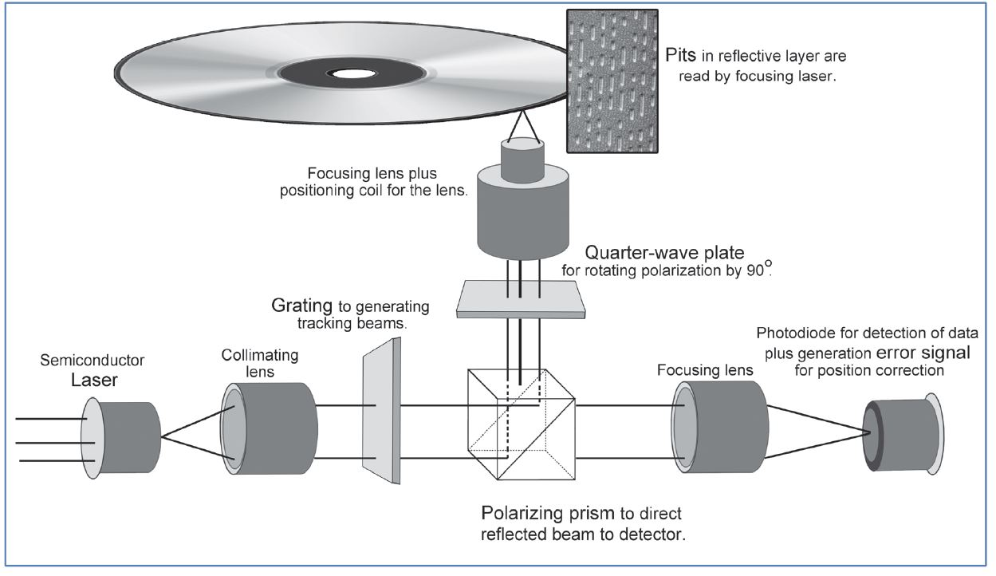
Figure 10-3 Digital optical storage systems

Slide 6
Figure 10-4 Lasers in surgery. (U.S. Navy photo by Mass Communication Specialist 1st Class Brien Aho, RELEASED).

Slide 7
Figure 10-5 Laser jet printer system

Slide 8
Figure 10-6 3-D Printer with typical images

Slide 9
Figure 10-7 Applications for laser range finders. (Courtesy of Kustom Signals).

