Slide 1
Metrology of Optical Systems
Figures and Images for Instructors
Module 2
Non-Interferometric
Measurement of Optical Performance
Precision Optics Series

Slide 2
© 2018 University of Central Florida
This text was developed by the National Center for Optics and Photonics Education (OP-TEC), University of Central Florida, under NSF ATE grant 1303732. Any opinions, findings, and conclusions or recommendations expressed in this material are those of the author(s) and do not necessarily reflect the views of the National Science Foundation.
Published and distributed by
OP-TEC
University of Central Florida
http://www.op-tec.org
Permission to copy and distribute This work is licensed under the Creative Commons Attribution-NonCommercial-NoDerivatives 4.0 International License. http://creativecommons.org/licenses/by-nc-nd/4.0. Individuals and organizations may copy and distribute this material for non-commercial purposes. Appropriate credit to the University of Central Florida & the National Science Foundation shall be displayed, by retaining the statements on this page.

Slide 3
Figure 2-1 In protective cases, precision physical distance and angle references called gauge blocks are shown here. (Photos courtesy Firas Almarzouk of Supply Chain Optics.)

Slide 4
Figure 2-2 A source of finite size, as given by the equation below, is collimated into a beam of planar wavefronts by the ideal lens that represents a well-corrected collimator

Slide 5
Figure 2-3 The point-source microscope (PSM) is a valuable optical alignment tool acting as a point source for integration and alignment applications.

Slide 6
Figure 2-4 Ronchi rulings like these are precision glass plates with periodically alternating transparent and opaque (or reflective and transmissive) regions. These Ronchi rulings have features at 3 and 4.7 lines per millimeter (l/mm), which may not be apparent if this image is rendered at a low resolution.

Slide 7
Figure 2-5 The 1951 USAF Bar Chart: an array of Ronchi rulings is often used as the object or target during measurement of optical system parameters

Slide 8
Figure 2-6 This figure shows the autocollimation technique used to test an optical system with a positive focal length

Slide 9
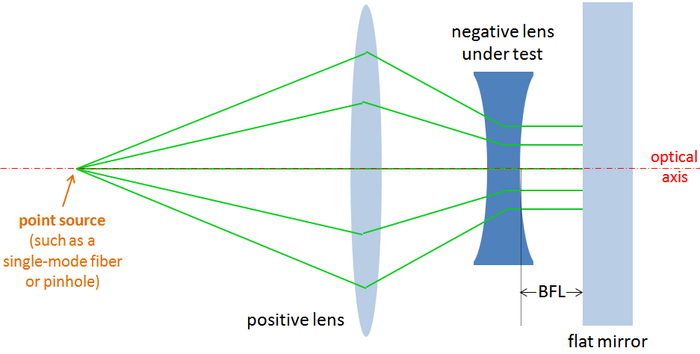
Figure 2-7 This figure shows the autocollimation technique used to test an optical system with a negative focal length

Slide 10
Figure 2-8 This traditional Ronchi test configuration for a mirror.

Slide 11
Figure 2-9 This novel and robust test configuration, conceived by Malacara-Doblado, et al., uses Ronchi rulings to measure the EFL and other optical properties of an optical system.

Slide 12
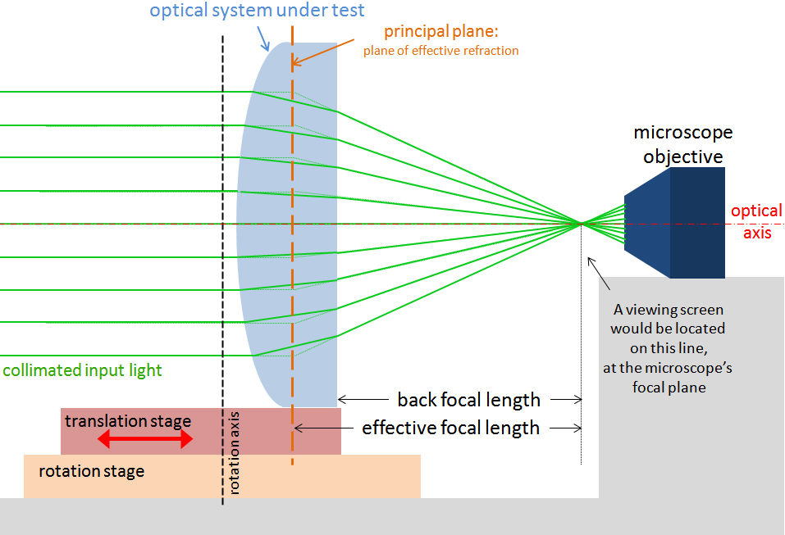
Figure 2-10 This figure shows the plan and side view of a nodal slide with a microscope used to view the image in space—the finely dashed line represents the image plane that is viewed by the microscope or the plane at which a screen or sensor would be placed.

Slide 13
Figure 2-11 A focimeter like the optical instrument shown here might be used in an optometrist’s office or at an eyeglass merchant. Its layout resembles a microscope in that the user looks in the eyepiece, and the eyeglass lens under test is inserted in the gap at the center of the instrument.

Slide 14
Figure 2-12 This figure shows the operation of the focimeter without (top) and with (bottom) the optical system under test. The addition of the optical system under test moves the position of the reticle from EFL_{focimeter} to d_{reticle}, thereby allowing calculation of the BFL for the optical system under test.

Slide 15
Figure 2-13 Alignment telescope configured to image an object of size h_{object} to optical infinity

Slide 16
Figure 2-14 For every fixed object-to-image separation, an optical system will form images at two different magnifications, depending on the location of the optical system between its object and image.

Slide 17
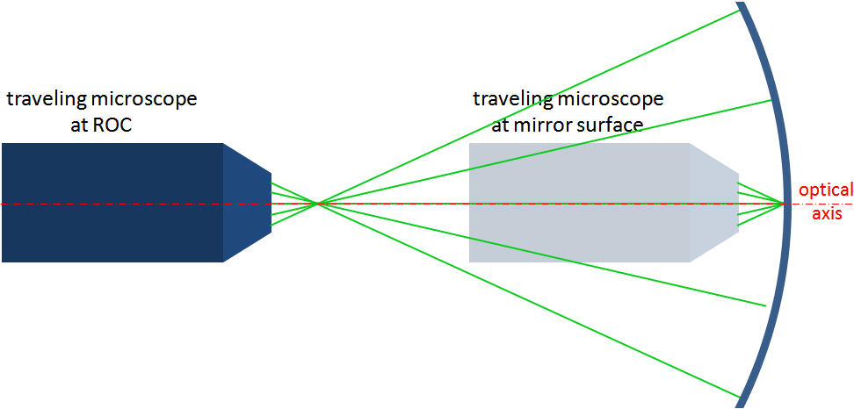
Figure 2-15 The traveling microscope shown is focused on a lens surface. The microscope focuses on a point on an optic. It is focused in the schematic to a point on an optical surface in the right configuration, and at the surface’s radius of curvature (ROC) in the left configuration.

Slide 18
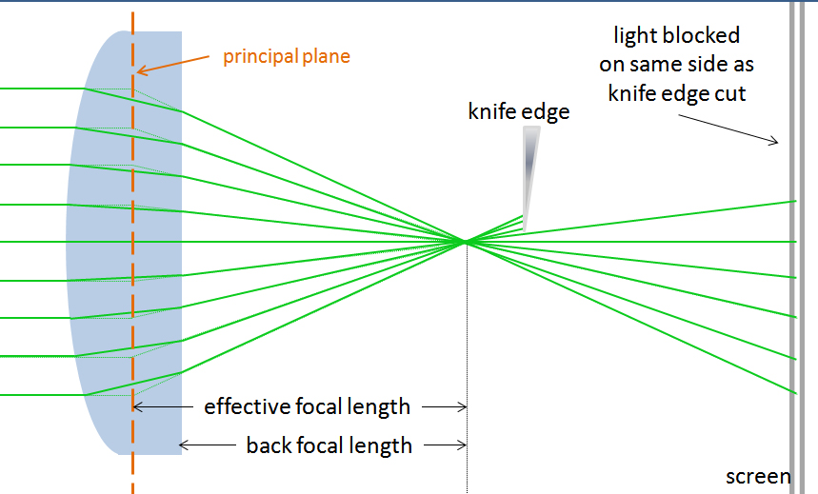
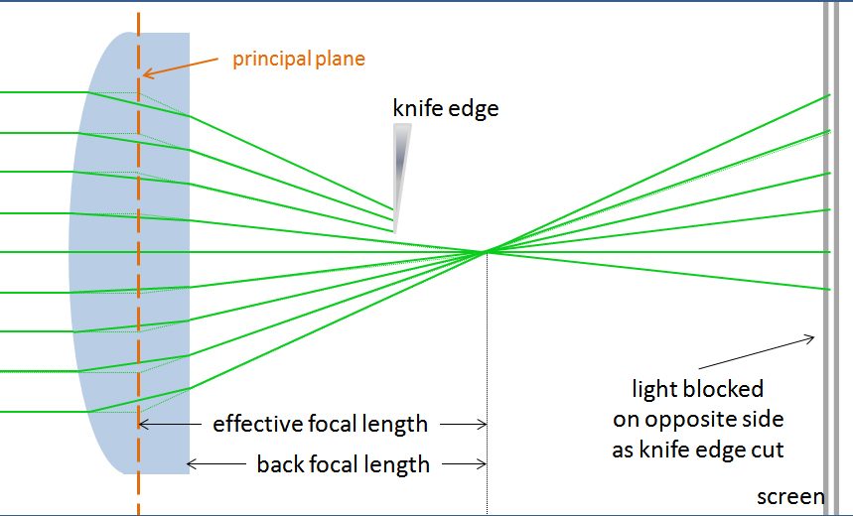
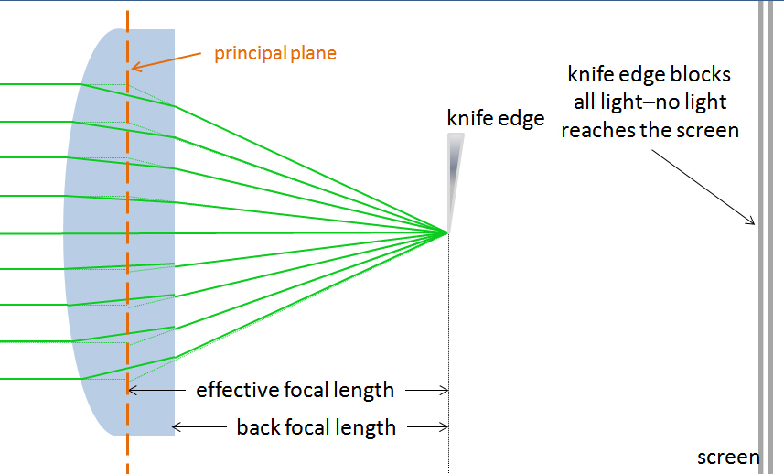
Figure 2-16 The set up for the Foucault test is shown, illustrating the results that will be observed on a screen when the knife edge cuts the beam before, after, and at the focal point of the lens

Slide 19
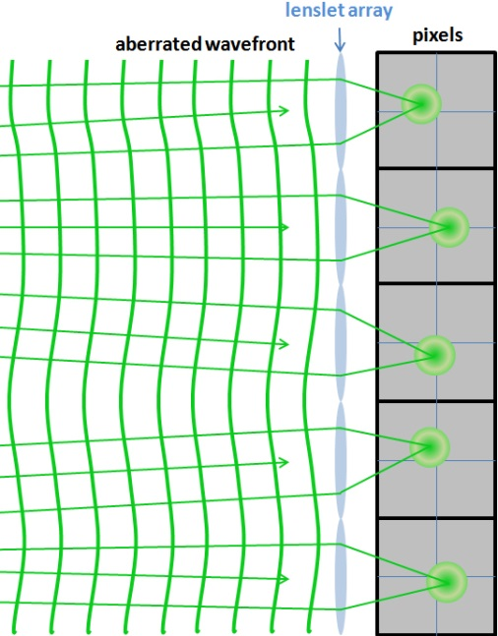
Figure 2-17 These figures show (top) the ideal spot locations for a collimated, unaberrated plane wave, and (bottom) the spot locations for the different subaperture tilts of an aberrated wavefront in a Shack-Hartmann wavefront sensor configuration.

Slide 20
Figure 2-18 Each of the four small squares represents a camera pixel. The transverse (x, y) location of a spot that illuminates this 2-by-2 pixel region will be determined by Equation 2-6, in which A, B, C, and D are the optical power values in each of the pixels.

Slide 21
Figure 2-19 The CMM shown in the figure is outfitted with multiple probes that measure the surface of the diamond-turned asphere. (Photo courtesy OPN.)

Slide 22
Figure 2-20 A laser tracker is shown in the background on this image, and two SMRs are located on the optical breadboard in the foreground. (Photo courtesy OPN.)

Slide 23
Figure 2-21 These figures show how the contrast is more poorly imaged for objects with higher spatial frequency than for low-spatial-frequency objects.

Slide 24
Figure 2-22 Block diagram of an MTF-measurement system

Slide 25
Figure 2-23 Mid-spatial frequency error will manifest itself if ripples like those shown here are evident in an interferogram. (Courtesy R. Youngworth and U. Fuchs)

Slide 26
Figure 2-24 The through-focus MTF of a simple lens system shows the MTF at a particular frequency (here, at 10 cycles/mm) over a range of focal plane locations, focus shifts from -5.0 to +5.0 mm. It is apparent that the modulation peaks for a focus shift that is approximately 2.5 mm from the nominal focal position.

