Slide 1
Quality Assurance of Precision Optics
Figures and Images for Instructors
Module 1
Fabrication of Precision Optics
Precision Optics Series

Slide 2
© 2018 University of Central Florida
This text was developed by the National Center for Optics and Photonics Education (OP-TEC), University of Central Florida, under NSF ATE grant 1303732. Any opinions, findings, and conclusions or recommendations expressed in this material are those of the author(s) and do not necessarily reflect the views of the National Science Foundation.
Published and distributed by
OP-TEC
University of Central Florida
http://www.op-tec.org
Permission to copy and distribute This work is licensed under the Creative Commons Attribution-NonCommercial-NoDerivatives 4.0 International License. http://creativecommons.org/licenses/by-nc-nd/4.0. Individuals and organizations may copy and distribute this material for non-commercial purposes. Appropriate credit to the University of Central Florida & the National Science Foundation shall be displayed, by retaining the statements on this page.

Slide 3
Figure 1-1 Large band saw for initial cutting of raw material

Slide 4
Figure 1-2 Circular saw for intermediate precision cutting

Slide 5
Figure 1-3 Wax block on parallel metal plate

Slide 6
Figure 1-4 Setup of a parallel machining operation

Slide 7
Figure 1-5 Mirror substrate being edged to diameter using diamond wheel and edging machine

Slide 8
Figure 1-6 Mirror substrate before and after edging

Slide 9
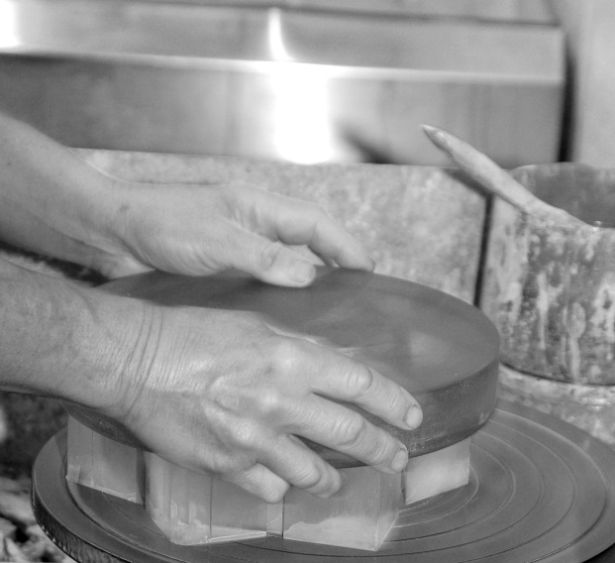
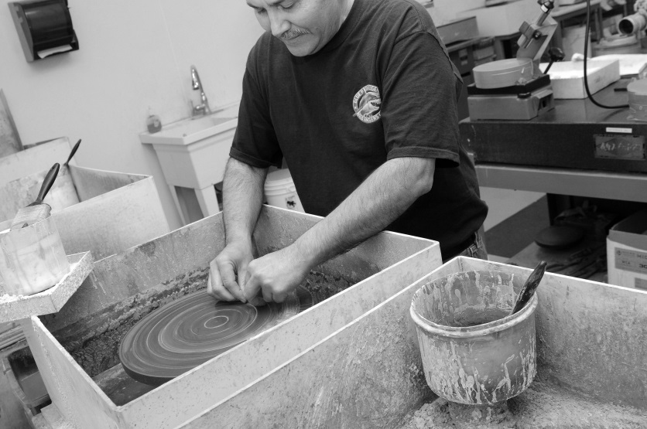
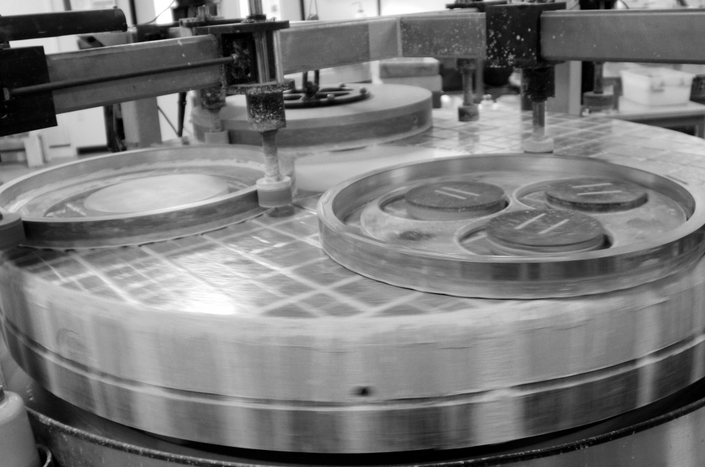
Figure 1-7 Upper left: Hand grinding a block of prisms
Upper right: Precision hand grinding an individual prism
Bottom: Continuous polishing machine that is pitch-polishing various substrates

Slide 10
Figure 1-8 Precision polished optical surfaces

Slide 11
Figure 1-9 Prisms painted to protect finished optical surfaces

Slide 12
Figure 1-10 Optics blocked in pitch

Slide 13
Figure 1-11 Optics blocked in plaster

Slide 14
Figure 1-12 Deblocking a plaster block

Slide 15
Figure 1-13 Basket of paint-protected optics being loaded into a degreasing machine to remove pitch and plaster

Slide 16
Figure 1-14 Tooling optics in degreasing basket

Slide 17
Figure 1-15 Optical plastic injection mold

Slide 18
Figure 1-16 Single-point diamond turning (SPDT) system cutting a plastic lens

Slide 19
Figure 1-17 A precision assembly technician applying optical adhesive to the hypotenuse surface of a right-angle prism before bonding it to another right-angle prism to create a beamsplitter cube

Slide 20
Figure 1-18 Shielding for a coating chamber, contaminated after multiple coating runs

Slide 21
Figure 1-19 Specular versus diffuse reflection

Slide 22
Figure 1-20 Graphical definition of focal length and radius

Slide 23
Figure 1-21 Light propagating through cylindrical lenses

Slide 24
Figure 1-22 Lens types

Slide 25
Figure 1-23 Four different slices through a cone pair create the four types of conic sections that are used to make aspheric optical surfaces

Slide 26
Figure 1-24 Comparison of the images formed of a distant object by a spherical and paraboloidal mirror

Slide 27
Figure 1-25 Elliptical whispering gallery

Slide 28
Figure 1-26 Graphical definition of surface sag

Slide 29
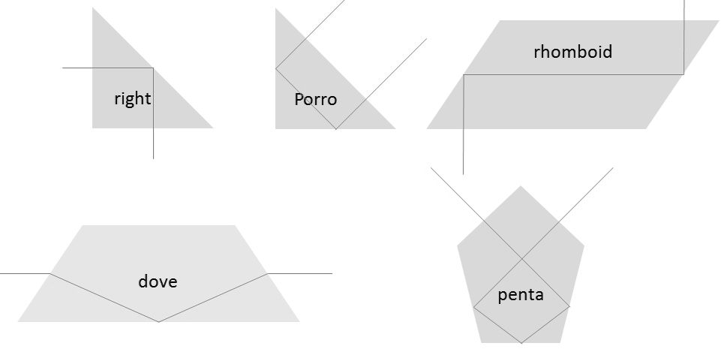
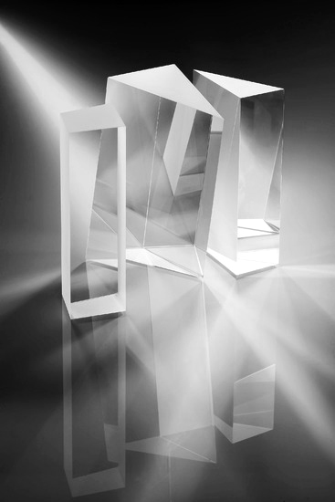
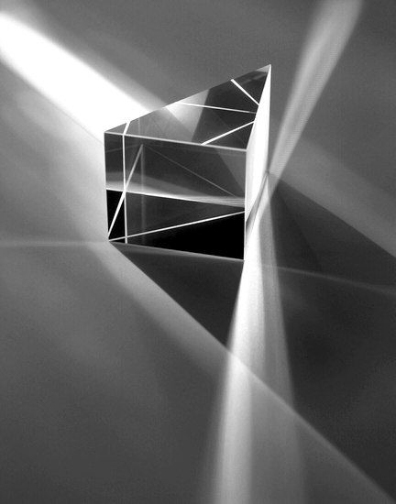
Figure 1-27 Common types of prisms

Slide 30
Figure 1-28 Shadowgraph

Slide 31
Figure 1-29 Experiment coatings

